Slide 1
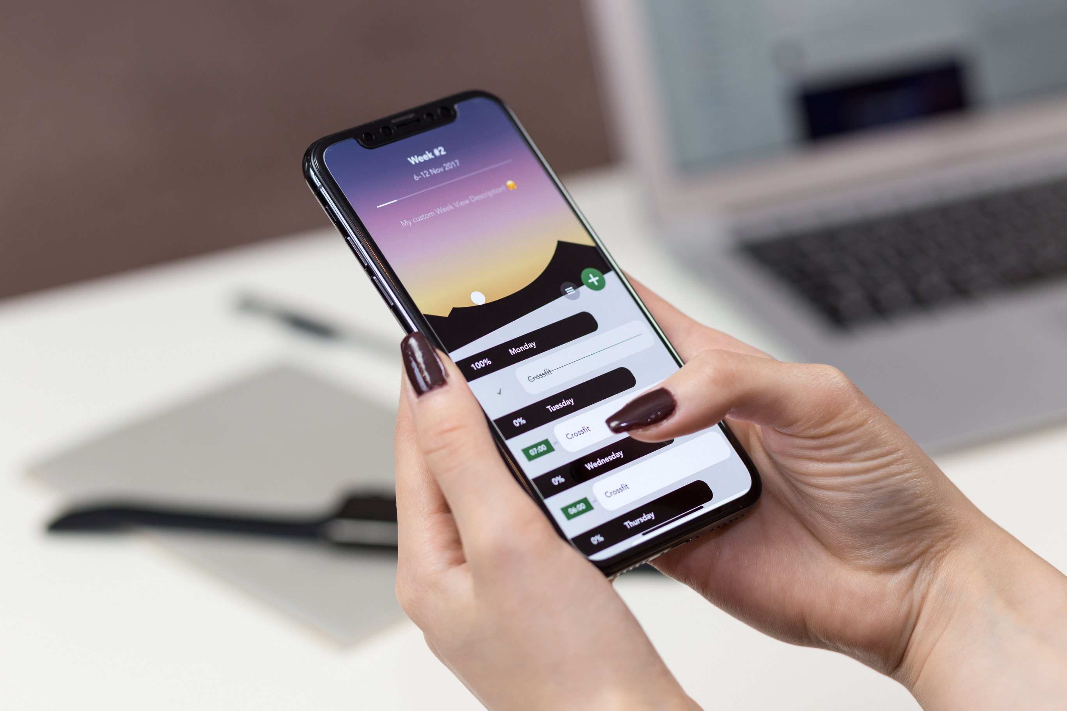
CanPay
ONE STOP SHOP FOR ALL YOUR BANKING AND BUDGETING NEEDS

Slide 2
TEAM MEMBERS | ROLE | STRENGTHS | EXPERIENCE
NEHA PATIL | BUSINESS ANALYST | BA knowledge, Data Analysis, Business Intelligence | 3 years in Business Analysis, Data exploration, and Data analysis.
VASU KHANNA | QUALITY ASSURANCE ANALYST | BA knowledge, Data Analysis | 2 years in Business Analysis, Data exploration, and Data analysis.
GARIMA ARORA | DATA ANALYST | Business Acumen, Data Analysis Interpretation & Management | 3+ Years as an SAP Consultant and managing Asset Performance Management
KESHAV DUTT GODIYAL | USER EXPERIENCE DESIGNER | Communication skills, BA knowledge, Financial Accounting Knowledge | 2 years in Audit
MUHAMMAD ISHAQ KHAN | PROJECT MANAGER | BA knowledge, C# development & QA testing | 3 years in Application Development & Testing
SHIVAM KARANGUTKAR | TECHNICAL ANALYST | Database, Data extraction, ETL | 3+ years in big data and development
ABOUT US

Slide 3


Managing multiple bank accounts and crafting effective budgets pose significant challenges for users in today's complex financial landscape which often results in confusion and inefficiencies in financial management. Users face challenges as they have to navigate through different banking platforms for seamless transfers and for accessing insights into their spending patterns.
Our solution, CanPay, aims to transform online banking and budgeting by offering a complete solution that streamlines account management, making it easier to transfer money between accounts with a wallet feature, and gives users insightful information about their spending to help them make smart financial decisions.
PROBLEM STATEMENT AND SOLUTION

Slide 4



PRODUCT AND VALUE PROPOSITION
CanPay is a mobile app streamlining the management of multiple bank accounts. With a user-friendly interface, users seamlessly integrate accounts, enabling easy transfers and gaining insights into spending—All in one place.
CanPay ensures effortless inter-account transactions and provides valuable expenditure insights, saving time and promoting informed financial decisions in a centralized hub.

Slide 5

CanPay Features and Functions:
Seamless Inter-Account Transactions: Send and receive money effortlessly using registered mobile numbers.
Expense Tracking and Management: Efficient financial management through seamless
integration and valuable insights into spending patterns for informed decision-making.
Personalized Wallet: Seamlessly transfer funds between wallet and added bank accounts.
Real Time Notification System: Enhance the speed and accuracy of expense tracking by enabling real-time updates and notifications for every transaction.
Robust Security Measures: Continuously improve and innovate security features to protect users' financial data and privacy, utilizing the latest technologies.

Slide 6



POTENTIAL CLIENTS
Busy Professionals: Manage finances efficiently amid a hectic schedule with centralized account management and quick transactions.
Students: Simplify budgeting and financial tracking for students managing allowances, part-time jobs, and educational expenses.
Small Business Owners or Entrepreneurs: Efficiently handle business finances with the ability to integrate business and personal bank accounts.
Budget-Conscious Consumers: Empower users looking to maintain strict budgets with insights into spending patterns and easy budget tracking.
Savers and Investors: Offer a comprehensive tool for individuals focused on savings and investments, providing insights into financial goals.
Individuals with Irregular Income: Assist those with irregular income streams by simplifying the management of varied income sources.
Retirees: Provide a user-friendly tool for retirees to manage their finances, ensuring easy access to pension and other accounts.

Slide 7
SOLUTION COMPARISON
Features/Functions | CanPay | Mint | ApplePay | Interac E-Transfer
Seamless Inter-Account Transactions | ✓ |  |  | ✓
Wallet Feature | ✓ |  | ✓
Expense Tracking and Management | ✓ | ✓ |  | ✓
Real Time Notification System | ✓ | ✓ | ✓ | ✓
Security Measures | ✓ | ✓ | ✓ | ✓

Slide 8

THANKYOU
By : GROUP 9

